Slide 1
Lesson 8
Wǒ xiǎng hē chá.
I’d like some tea.

Slide 2
Text1 New Words
Xiǎng want , would like
Hē drink
Chá tea
Chī eat
mǐ fàn cooked rice

Slide 3
Text 1 : In a restaurant
A: Nǐ xiǎng hē shén me ？
B: Wǒ xiǎng hē chá.
A: Nǐ xiǎng chī shén me ？
B: Wǒ xiǎng chī mǐ fàn.
want,
would like
drink
tea
eat
rice

Slide 4
Text2 New Words
Xià wǔ afternoon
shāng diàn shop , store
mǎi buy , purchase
Gè a general measure word
bēi zi cup , glass

Slide 5
Text 2 : In the living room
A: Xià wǔ nǐ xiǎng zuò shén me ？
B: Xià wǔ wǒ xiǎng qù shāng diàn.
A: Nǐ xiǎng mǎi shén me ？
B: Wǒ xiǎng mǎi yī gè bēi zi.
shop, store
buy
cup, glass

Slide 6
Xiǎng
Hē
Chá
Chī
mǐ fàn
Xià wǔ
shāng diàn
mǎi
Gè
bēi zi

Slide 7
Money

Slide 8

Name Of Chinese Currency Rén Mín Bì
RMB
yuán
1 RMB = 22 PKR

Slide 9
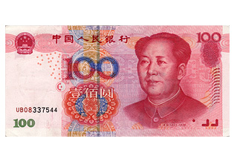
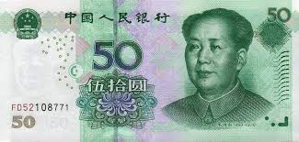
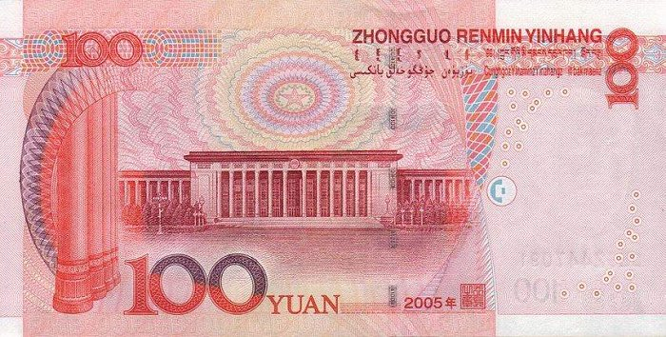
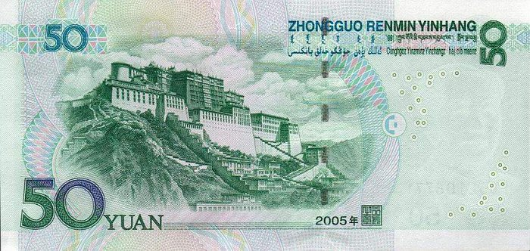
¥ 100
¥ 50

Slide 10
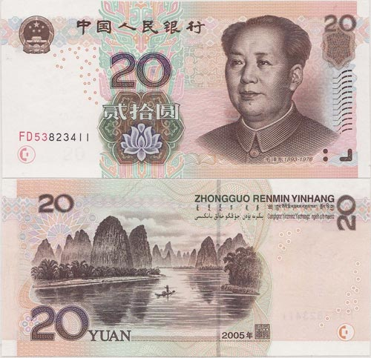
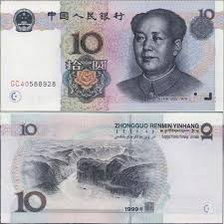
¥ 20
¥ 10

Slide 11
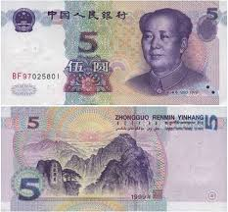
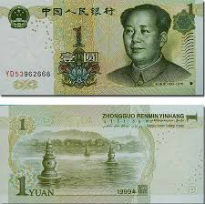
¥ 5
¥ 1

Slide 12
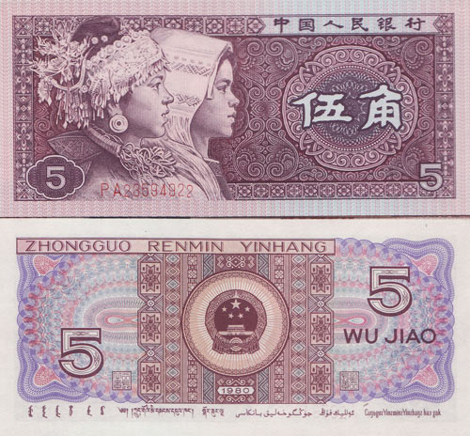
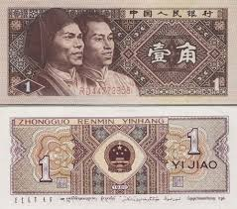
¥ 0.5
¥ 0.1

Slide 13
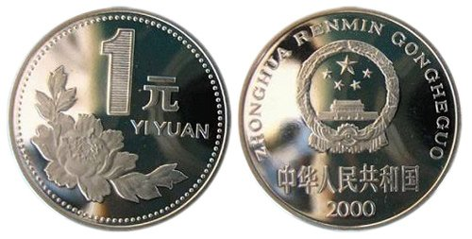
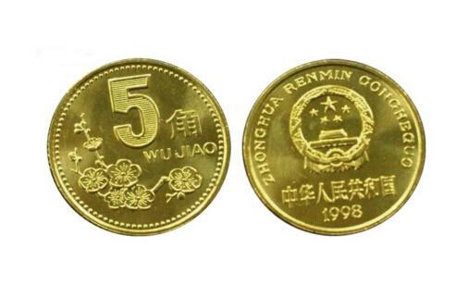

¥1
¥ 0.5
¥ 0.1

Slide 14
Text3 New Words
Zhè this
Nà that
duō shǎo how much , how many
Qián money
kuài yuán

Slide 15
Text3 : In a store.
A: Nǐ hǎo ! Zhè gè bēi zi duō shǎo qián ？
B: 28 kuài.
A: Nà gè bēi zi duō shǎo qián ？
B: Nà gè bēi zi 18 kuài (qián).
how much
money
yuan
that

Slide 16
Bargain: huán jià
Expensive : Guì
Cheap : Pián yi
Too expensive: Tài guì le
Make it cheaper: Pián yi diǎn er

